Slide 1
Arduino-Based Electrotactile Stimulation System For Virtual Sensory Feedback

Slide 2
Goals and Objectives
Objectives
Goal
Set up JIRA and Gitlab
Create software/hardware flowchart and diagrams
Implement design
Identify stimulation parameters/research papers (3 max)
Simulation/Evaluation
To recreate the sense of contact made with touching an obstacle in the 3D environment. This will be achieved by delivering localised stimulation to the tips of the wearers fingertips.
Notes:
Objectives:
JIRA/GITLAB - Forming a plan/process, and figuring out what I need, what I need to do and why. Use of JIRA and Gitlab is fundamental in managing this objective
Software/Hardware Diagrams - To help with laying out the development groundwork of hardware and software creation
Implementation - Actual building of hardware and software to allow for signal conversion for feedback stimulation and interaction with virtual world respectively. As well as compatibility testing for software and hardware
Goal:
Elaborating on the project title, a glove will be worn by a user, and mapping of the finger movements will determine whether contact with a virtual object has been made. Upon contact, the user will experience electrotactile stimulation on their fingertips, sufficient enough to give the impression of touch.

Slide 3
Implementation
HARDWARE UNIT
ARDUINO
MICROCONTROLLER
SOFTWARE UNIT
GUI
SIGNAL GENERATOR
Software Unit
Hardware Unit
Component elements
SIGNAL CONVERTER
DATA GLOVE
ELECTRODES
VOLTAGE SOURCE
Notes:
Block diagram overview of the whole system
A general overview of how the main system components are linked together.
System Architecture shows a usb power supply (5V) driving the 5DT Data Glove and Arduino microcontroller which in turn feeds into the waveform modulation section consisting of the signal generator, signal converter and electrodes.
Arduino
Internal voltage regulator to reduce input power supply voltage to 3.3V

Slide 4
Implementation
Name | Electrotactile glove stimulator prototype
Purpose | To provide electrotactile stimulation to the fingertips once virtual contact of an object has been made, representative of the feeling of touch.
Inputs | USB power supply
Outputs | Waveform signal, electrodes
Functions | Finger position determination, virtual tactile sense provider
Performance | Provide real-time feedback of contact with minimal lag
Physical size/weight | No larger than a hand, no heavier than a standard glove
Notes:
Requirements form table detailing some general characteristics of the system

Slide 5
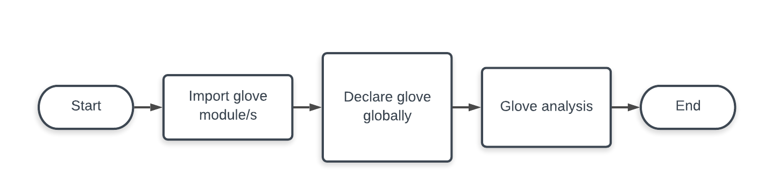

Implementation
2
3
1
1
2
3
Notes:
Vizard Main Glove Flowchart
Code first identifies what port the glove is on.
Vizard modules ‘addSensor’ to include the 5DT Data Glove plugin and request a sensor object (collection of data) from it. This sensor object will contain the output positions of the fingers as well as orientation data that is attached it to the sensor variable.
Takes the keyword argument ‘hand.GLOVE_5DT’ and the positional argument ‘sensor’ to be passed to the function and assigns it to the ‘glove’ variable.

Slide 6
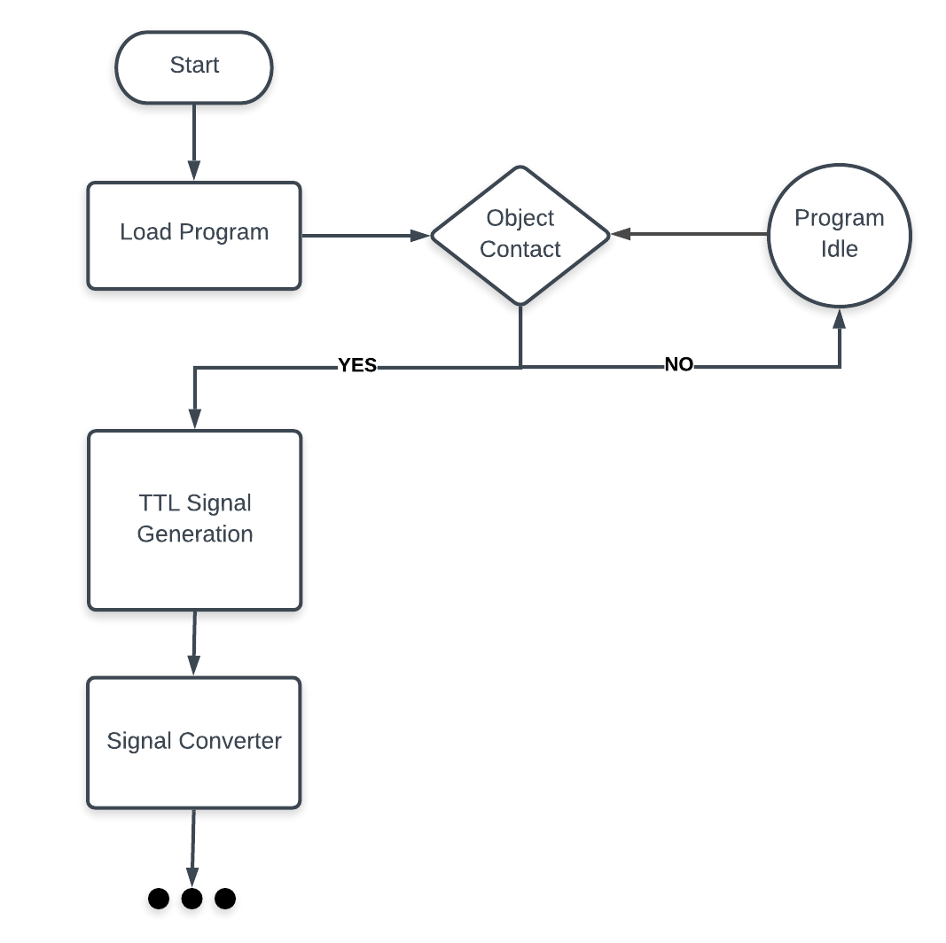
Implementation

Slide 7
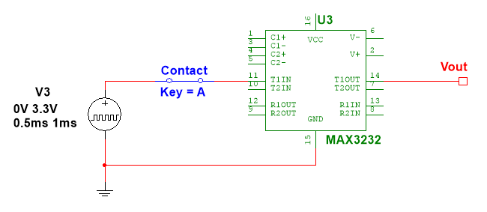
Implementation
Voltage Waveform Converter
Notes:
Voltage waveform
MAX3232
Optimum voltage – 3.3V

Slide 8
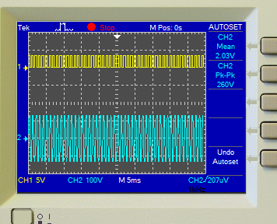
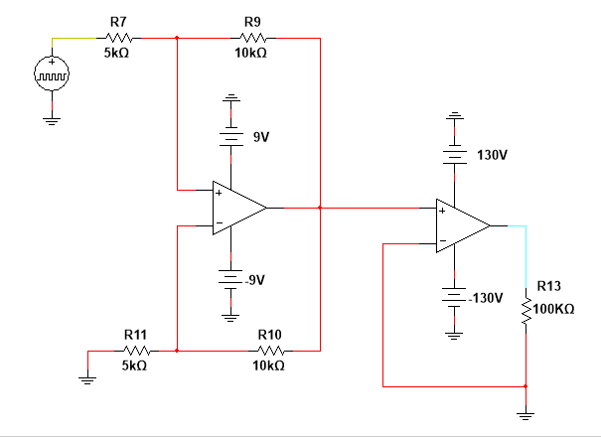
Results and Discussion
Oscilloscope reading
Signal converter/amplifier
Notes:
Hardware circuitry schematic

Slide 9
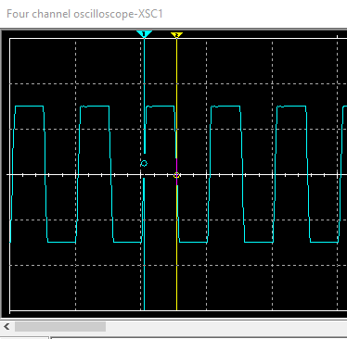
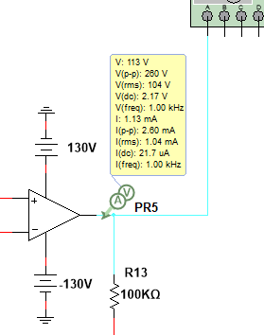

Results and Discussion

Slide 10
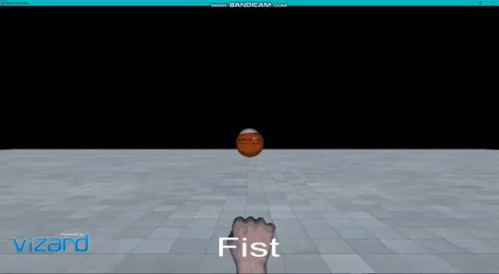
Results and Discussion
Notes:
GUI video snippet

Slide 11
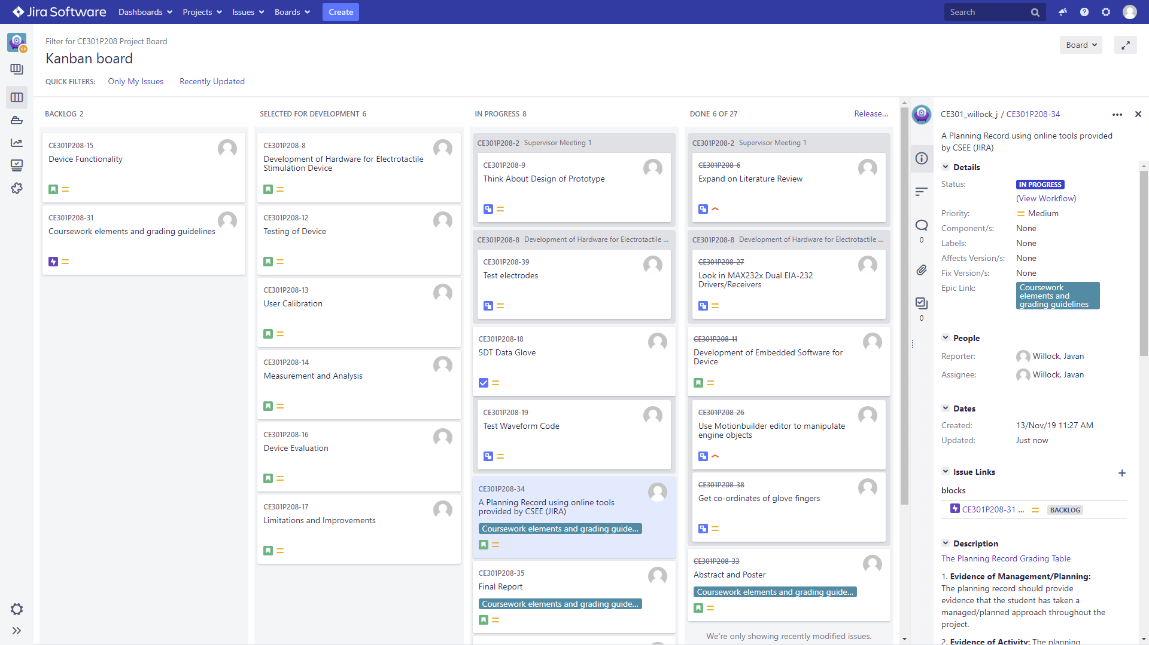
Project Management - JIRA
Notes:
Jira
Provides the ability to simplify the organisation of work and allows for easier collaboration amongst developers to ensure goals are clear and easy to follow.
As an agile tool you can scale the project to your needs by breaking the objectives down into smaller tasks to achieve a solution.

Slide 12
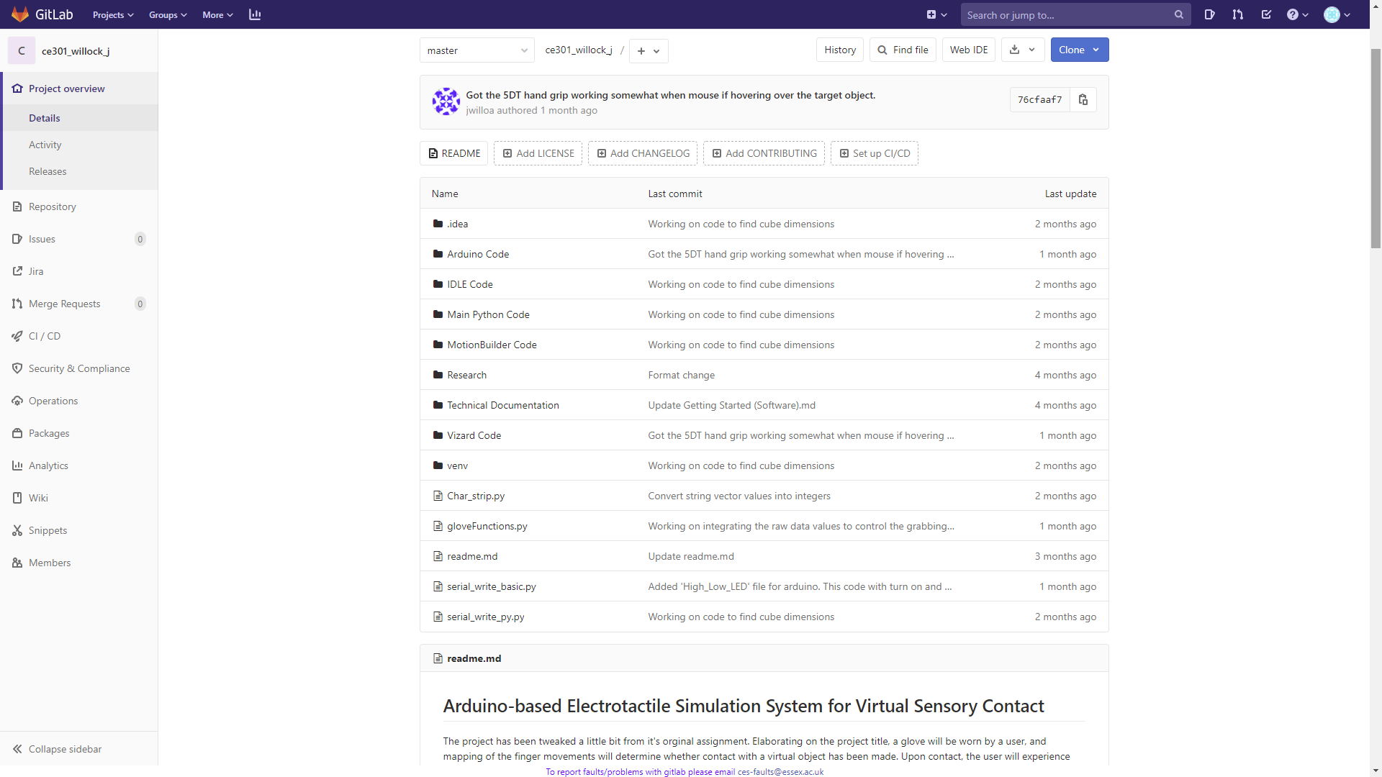
Project Management - GitLab
Notes:
Gitlab
A version control system, I use GitLab to manage the workload in a centralised repository to aid in project planning and source code management.
Version control software keeps track of every modification to the code in a special kind of database.

Slide 13
Conclusion
Implementation of voltage waveform converter and amplifier
Simulate and test circuit
Develop GUI

